Slide 1
Microelectronic Control Systems
Analog Inputs, Timers, Interrupts

Slide 2
Educational objectives
During this lecture you will learn
• Interfacing of MCUs with the real world
• details about different inputs: digital vs. analogue
• How to read input from a potentiometer
• What are the timers and prescalers
→How many timers are available in Atmega8
→What are the differences between timers
• How to use interrupts
→Software interrupts (e.g. timers etc.)
→Hardware interrupts (e.g. pushbuttons etc.)

Slide 3
Interfacing with the Real World
Digital microcontrollers are in the business of monitoring and controlling the real environment – which is commonly analogue in nature.
To interface with the environment, analogue to digital conversion (ADC) and digital to analogue conversion (DAC) is needed
analogue
world
Digital μC
based system
analogue
world
A/D
D/A

Slide 4
From analogue to digital signal
Error mainly due to sampling and quantisation.
3bits resolution
quantisised signal
analogue signal
111
110
sampled signal
101
100
011
010
001
000
error
Prof. Dr.-Ing. Ivan Volosyak

Slide 5
Analogue-digital conversion
although there are many different methods for ADC, by far the most common is the successive approximation technique:
_ In each step, halve the range within which the solution is known to lie.
_ Start by comparing V_{in} with (1/2)V_{DD}. This tells us whether the voltage is in the top or bottom half of the range — gives most significant bit (MSB) of converted value.
_ If it is in the bottom half (say), we next compare V_{in} with (1/4) V_{DD}. This tells us whether the voltage is in the top or bottom half of the subrange (i.e. first or second quarter) and gives the second most significant bit.
_ Carry on halving the range until enough bits have been generated.
_ Look at an example that generates four bits.

Slide 6
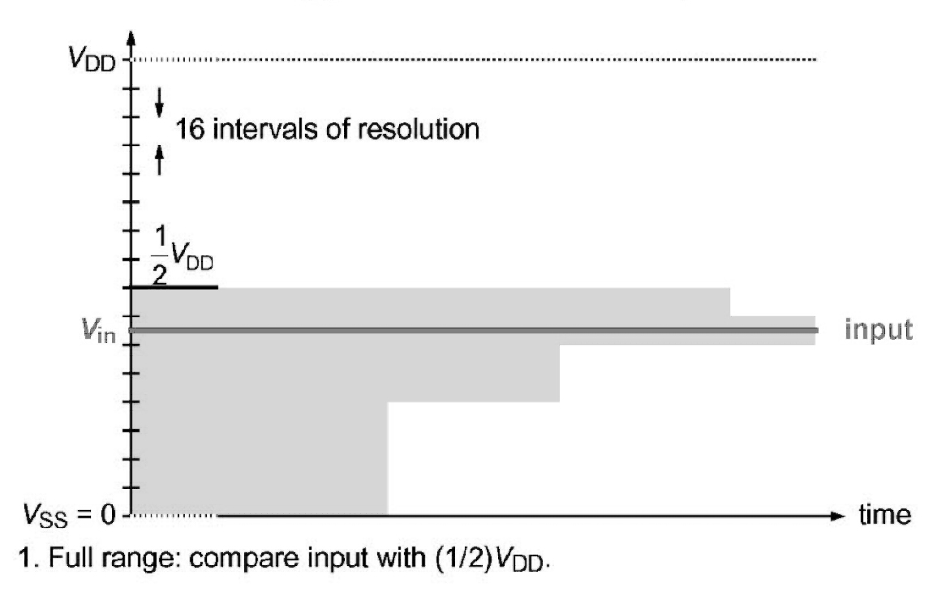
Successive approximation technique: 4 bit ADC

Slide 7
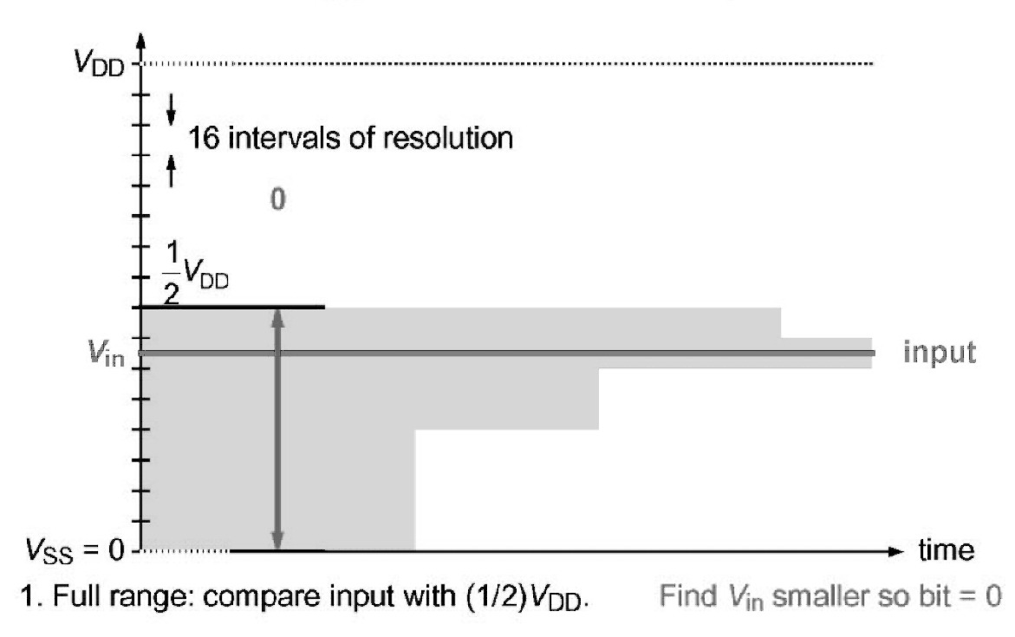
Successive approximation technique: 4 bit ADC
Prof. Dr.-Ing. Ivan Volosyak

Slide 8
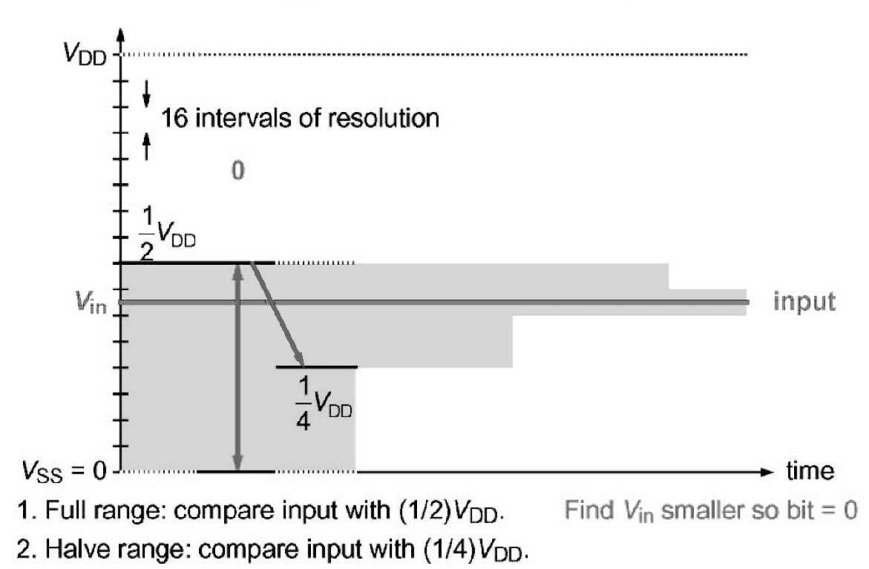
Successive approximation technique: 4 bit ADC
Prof. Dr.-Ing. Ivan Volosyak

Slide 9
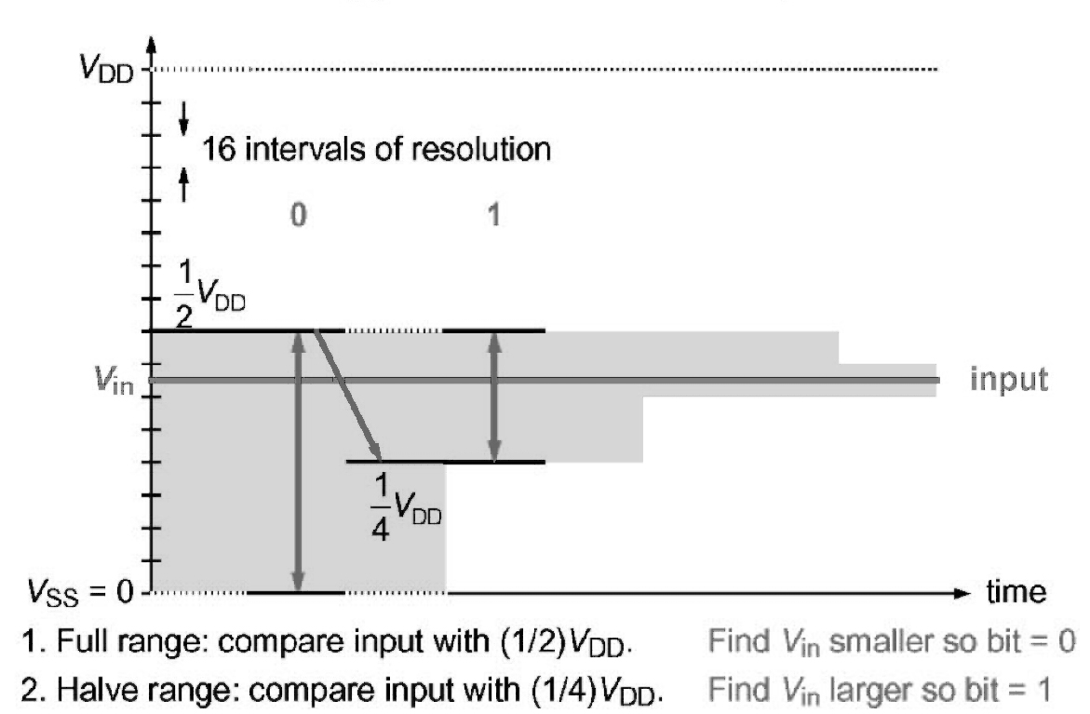
Successive approximation technique: 4 bit ADC
Prof. Dr.-Ing. Ivan Volosyak

Slide 10
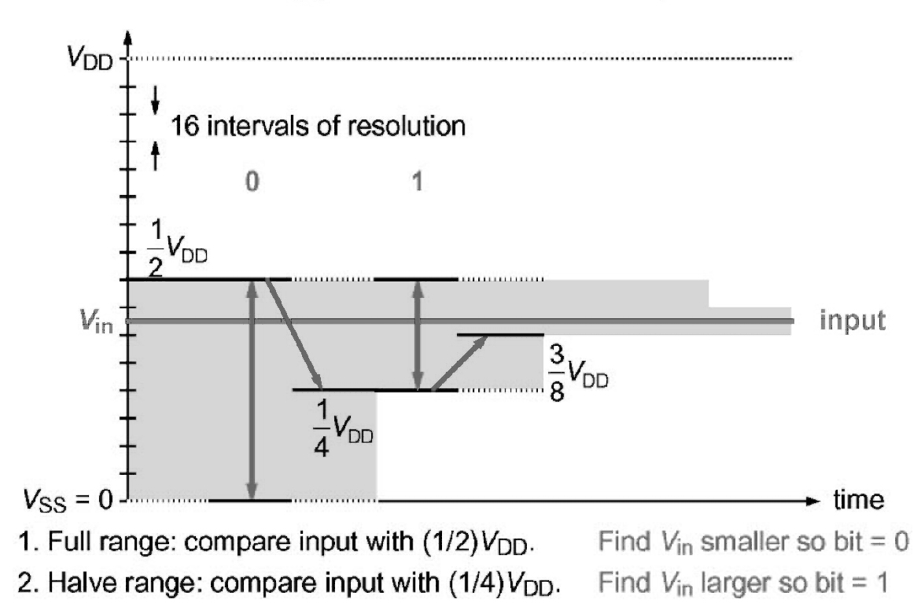
Successive approximation technique: 4 bit ADC
Prof. Dr.-Ing. Ivan Volosyak

Slide 11
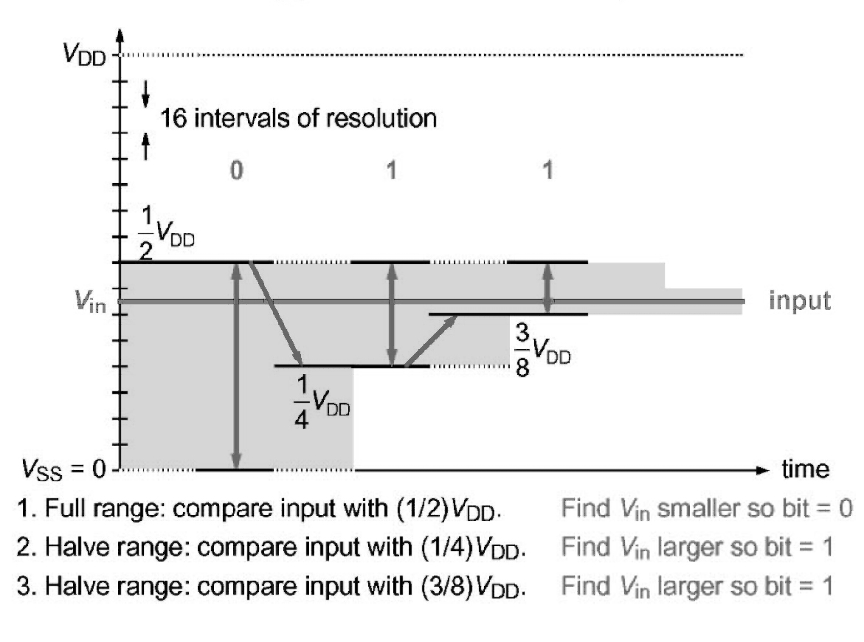
Successive approximation technique: 4 bit ADC
Prof. Dr.-Ing. Ivan Volosyak

Slide 12
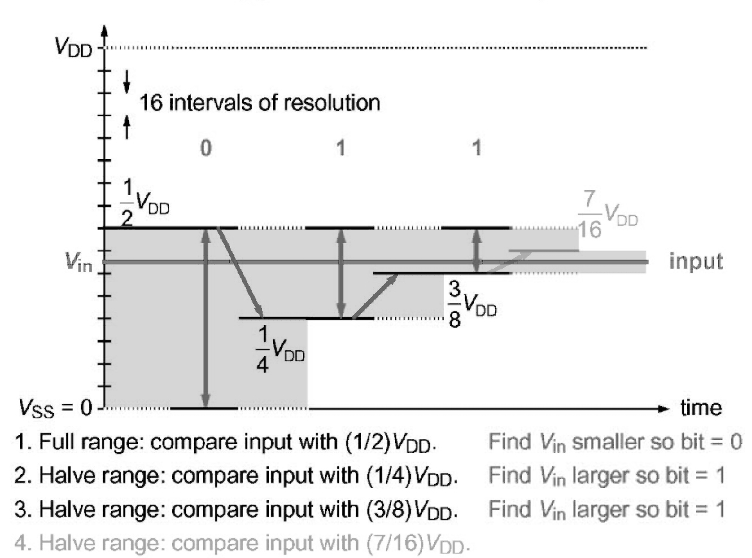
Successive approximation technique: 4 bit ADC
Prof. Dr.-Ing. Ivan Volosyak

Slide 13
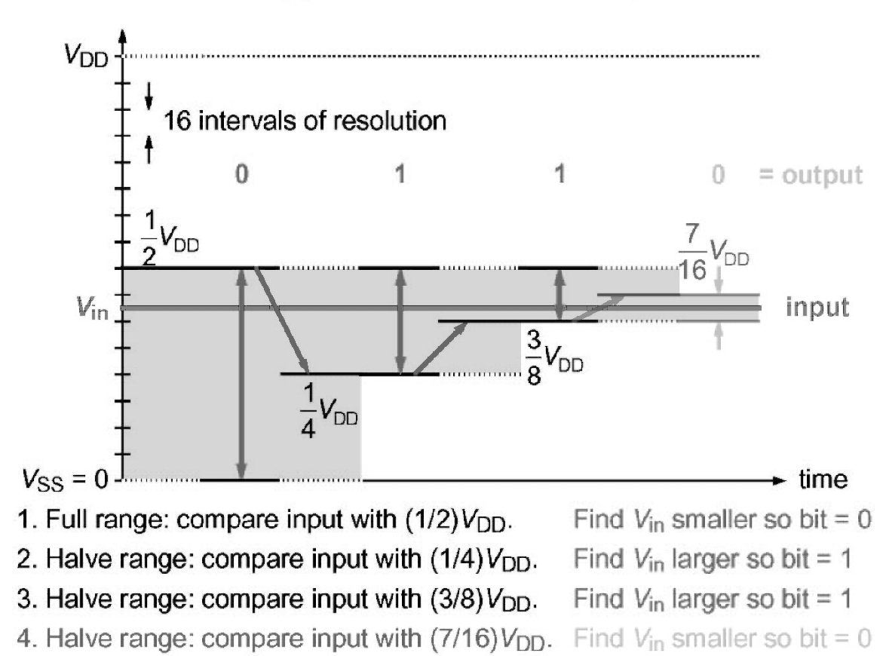
Successive approximation technique: 4 bit ADC
Prof. Dr.-Ing. Ivan Volosyak

Slide 14
Successive Approximation
Electronic implementation uses a network of precision resistors or capacitors.
They are configured to allow consecutive halving of the fixed voltage V_{ref} to be switched in to an analogue comparator.
Sample and Hold process (capacitor network):
_During the sample period, the network is connected to the analogue input voltage V_{in}
_During the hold period, the analogue input is disconnected and the charge at each capacitor is examined by the comparator.
Prof. Dr.-Ing. Ivan Volosyak

Slide 15
Successive Approximation - Summary
The successive approximation method produces one bit for each comparison, starting with the most significant bit (MSB).
Each step requires two clock cycles: one to change the reference voltage and one to make the comparison — 16 ADC clock cycles in all for an 8bit ADC.
The conversion is done by an ingenious network of switched capacitors:
_ must be slow enough for charge to redistribute on capacitors
_ must be done quickly enough that charge doesn’t leak away
_ hence ADC clock must be around 1 MHz, regardless of frequency of clock for rest of µC, which may run faster
Prof. Dr.-Ing. Ivan Volosyak

Slide 16
Task 2.3 Analog Input (from Practicals 1)
1.Connect a potentiometer to one of the analog inputs from the microcontroller.
2.Read the value and show it on the LCD display.
To get help how the analog to digital converter works, read the datasheet.
Lets find solutions to TODO parts of the code in datasheet together.
Please try to understand the process of finding the answers in the datasheet (file atmega8.pdf etc.) and use it in more difficult labs!

Slide 17
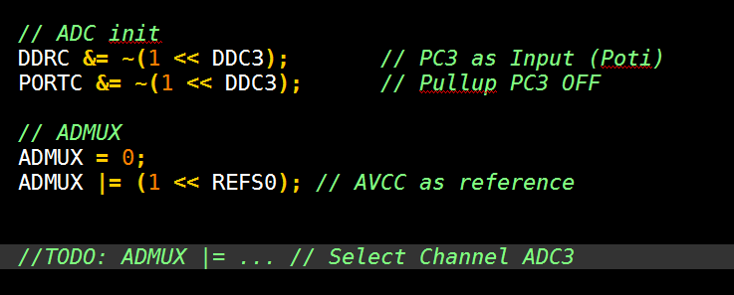
Analog Input – ADC channels
TODO1: How to select ADC3 channel

Slide 18
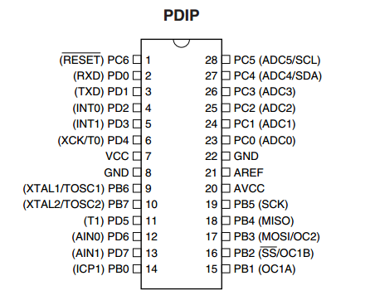
Analog Input – ADC channels
TODO1: ADC3 channel
In the code you will see a lot of comments talking about ADC
(Analog to Digital Converter).
The TODO1 is about choosing which pin (in this case ADC3). Notice that in schematic it is also said that PC3 is in fact the same as ADC3.
So the real meaning of our action „choose ADC3 Channel“ is to use input on PC3 for ADC conversion.
Hint: You should connect the potentiometer here.

Slide 19
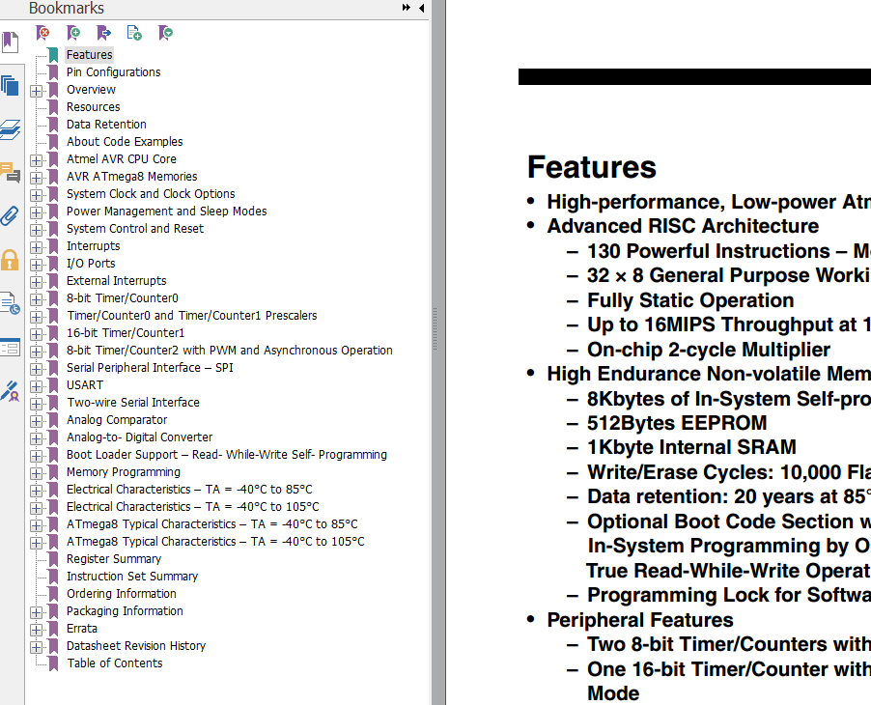
Analog Input – ADC of ATmega8
Back to the code
Step 1:
We need to find relevant part in the atmega8.pdf document.
Since we are talking about ADC settings, we will go to section
„Analog to Digital Converter“

Slide 20
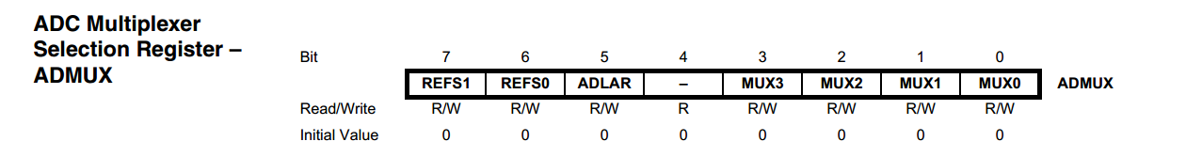
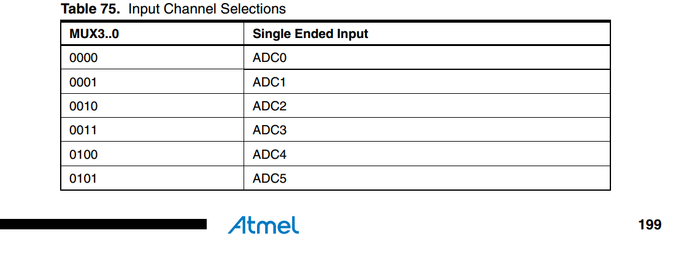
Analog Input – selection of ADC channel
Lets find information on ADMUX register (see hint in the code template ADMUX |= …) in the datasheet. On the page 199 you can find this:
Please note that these MUX bits are basically a binary representation of the ADC channel
Remember, we set a bit in a register using standard syntax
REG_NAME |= (1 << BIT_NAME);

Slide 21
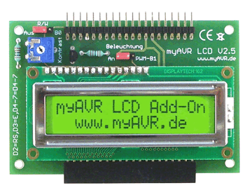
Using LCD
LCD can be very useful for debugging
and reading any sensor values. Luckily,
there are libraries you can use, which
makes using LCD easy.
Place files lcd.c and lcd.h in your working folder.
In the code: add
#include "lcd.h“
It is easiest to print strings on LCD. In C language it means an array of characters.
IMPORTANT: YOU HAVE TO DISCONNECT THE LCD IF YOU ARE USING INTERRUPTS (NEXT LABORATORY EXPERIMENT!!!)

Slide 22
Using LCD
A good way to form a string you need is sprintf command.
It has usual printf syntax, however, the output goes to a char array.
Example:
char str[16];
sprintf(str, "v: %d; r: %d", OCR1A, defVal);
Only what is in the “ “ will be put in the string. However, %d is a placeholder, so two of them will be replaced by the values of variables OCR1A, defVal. The result will be put in str.
IMPORTANT: YOU HAVE TO ENSURE THAT THE LENGTH OF THE RESULTING STRING DO NOT EXCEED 16 CHARACTERS!!!
There are more placeholders for other variables, including strings, so you can for example insert a name of a person in a predefined text.

Slide 23
Using LCD
So you have the string you want to print. What’s next?
lcd_clear(); //remove all previous info from LCD
lcd_string(str); //print the string “str”
And if you want to use both lines of the LCD display:
lcd_setcursor( uint8_t x, uint8_t y ); //experiment with it if you are interested.
Don‘t forget that you will need four lines in this case, e.g.
lcd_setcursor(x1,y1);
lcd_string(str1);
lcd_setcursor(x2,y2);
lcd_string(str2);

Slide 24
ADC initialization
ADC has many properties, which can be configured, so starting it will take a bit more then one line of code.
We will need:
Set Free-running conversion mode (convert all the time, not wait for any signal to make new ADC conversion)
Choose on what pin to read
Define prescaler (how often the ADC conversion must be performed, in some cases you can save a bit of power and more)

Slide 25
ADC initialization
ADMUX |= ???????????; //see previous explanations
ADMUX |= (1 << REFS0); //our board, AREF = Vcc
ADMUX &= ~(1 << REFS1); //our board, AREF = Vcc
ADCSRA |= (1 << ADEN); //ADC enabled
ADCSRA |= (1 << ADSC); //Do first conversion (in free running mode you don’t have to start it again
ADCSRA |= (1 << ADFR); //Free running mode on
ADCSRA |= (1 <<ADPS1) | ( 1 << ADPS0);
ADCSRA &= ~(1<<ADPS2); // prescaler = 8 for ADC, meaning ADC clock is 8 times slower when for the whole board

Slide 26
ADC precision
Imagine your documentation says you have 12-bit ADC.
Your input changes in the range from 0 to 5 Volts.
What does this mean?
It means that ADC will generate 12-bit variable (from 0 to 2^12-1=4095),
and one unit of this variable will correspond to 5V/4096,
or roughly 1,22 mV.
Now if you want for example to split your possible values to 4 value regions, LOW, MID_LOW, MID_HIGH, HIGH you would have to divide all your possible 4096 values of the output into four parts..
Our MCU ATmega8 hat 10 bit precision ADC and can therefore measure 2^10 = 1024 different values ranged 0...1023.

Slide 27
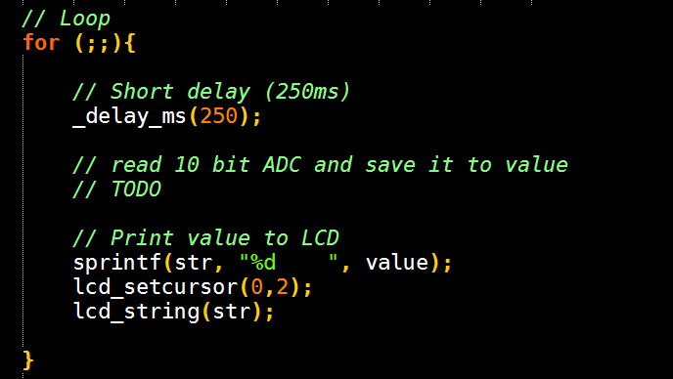
Analog Input – ADC value
TODO2: reading the value

Slide 28
Analog Input – ADC value
TODO2: reading the value
If we have the ADC set up correctly, it will fill some register in the memory of the microcontroller with the digital value measured at the selected input.
But which register should we use? Furthermore, we are asked to read 10 bit value. What is so special about 10 bit? It is more than register size of 8 bit!
The explanation waits for us in the AtMega8.pdf Datasheet on the pages 190 and 191.

Slide 29
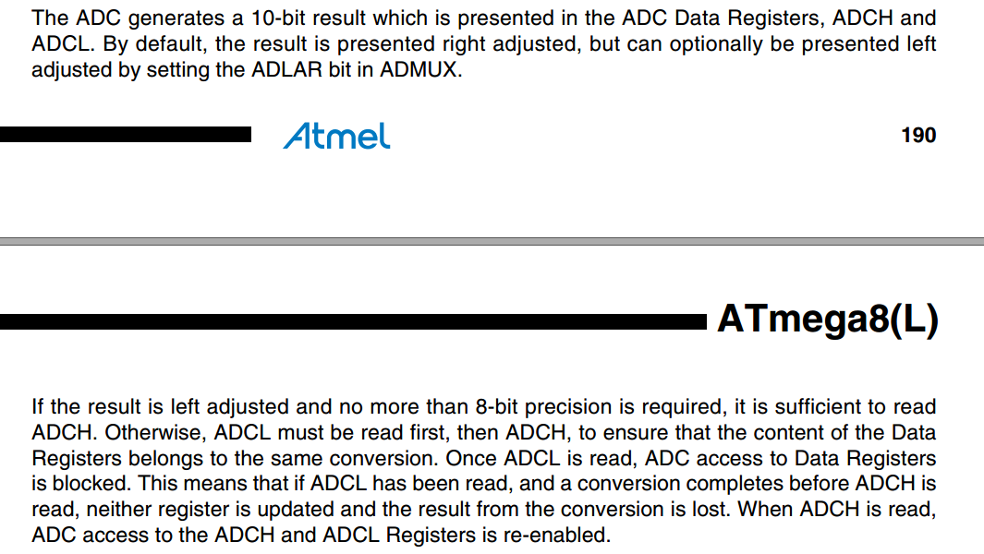
ATmega8 – 10 bit ADC value
TODO2: reading the value

Slide 30

ADC value = the sum of ADCH and ADCL?
TODO2: reading the value
So there is some procedure about reading ADCH and ADCL registers.
One of them must be multiplied by 2^8, and it all depends on settings – is it right-adjusted or left adjusted…
Special trick for lecture visitors:
ADCW (ADC Wide of ADC Whole)
ADCW contains the full number, ready to use. So just use this ADCW value directly:

Slide 31
Task 2.4 Timer/Counter (from practicals 1)
Write a program to flash one LED with 1 Hz with a Timer/Counter.
Find out the best Timer/Counter and prescaler settings to do this. The CPU speed is 8 MHz.

Slide 32
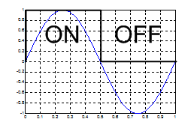
Period / Frequency
First, to make it clear: flashing LED with 1 Hz means the full cycle of switching on and off takes 1 second (period is inverse of the frequency).
In fact, we will start with LED off (for example),
„While(1)“
wait 500 ms, switch it on,
wait 500 ms, switch it off.
However, we are not allowed to use _delay_.. function!

Slide 33
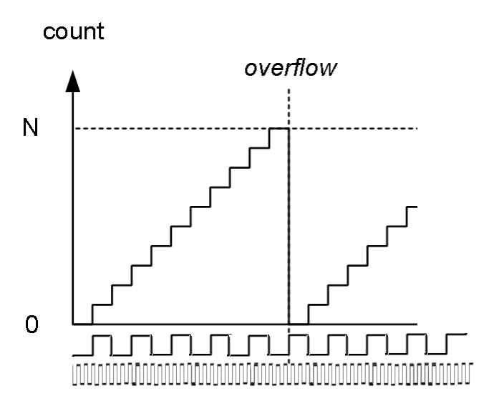
Timers/Counters of ATmega8
If you do not know, how Timer/Counter works:
It uses some clock (usually our quartz crystal, this clock can be divided by the prescaler) and keep incrementing value of some register: 1, 2, 3, 4, 5… up to maximal value 2^8 or 2^16.
These 3 registers are called for ATmega8
TCNT0 for timer 0, 8 bit timer/counter
TCNT1 for timer 1, 16 bit timer/counter
TCNT2 for timer 2, 8 bit timer/counter
N=255 for timers 0 and 2 and
N=65535 for timer 1
What happens upon reaching the maximum value? Overflow, the value in register is reset to 0, an interrupt is generated (will be explained later).

Slide 34
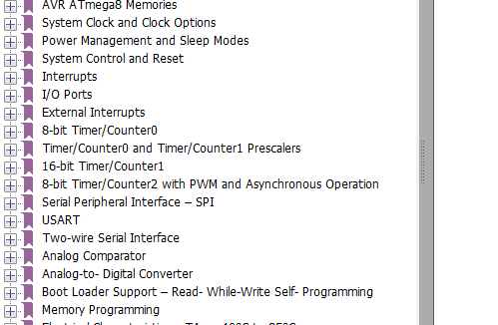
Details about Timers/Counters
Timers/Counters can do much more: they are also used for waveform generation (PWM) and can call some events automatically when a certain number of counts is reached (see compare registers).
All this is explained in detail in the datasheet atmega8.pdf!

Slide 35
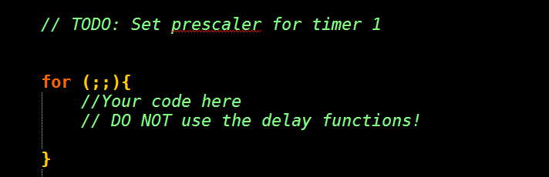
Back to the task 2.4
It is the time to look at the code and see the TODOs.
So first, prescaler for timer 1.

Slide 36
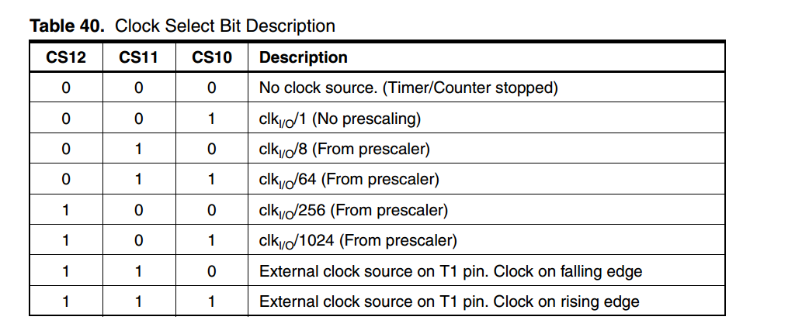
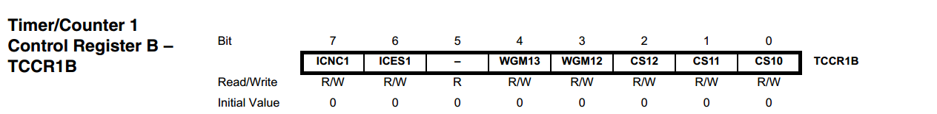
Prescaler for Timer/Counter 1 (16 bits!)
We go to the datasheet and open Timer1. We are looking for a register and a table which will describe how to choose prescaler. Searching for „prescaler“ we can find the following on pages 98 - 99:
E.g. prescaler of 1024: TCCR1B = (1<<CS12)|(1<<CS10);

Slide 37
Measuring of time with Timer 1
Imagine that you do the following:
TCNT1 = 0;
What value will the TCNT1 have 500 ms later? (assuming prescaler of 64)
Timer/Counter 1 will be incremented every 64 / 8M seconds (using prescaler of 64). To know the count value for 500ms, simply divide the time interval (500 ms) over one time unit value with this clock/counter:
0.5 s * 8M / 64 = 62500.

Slide 38
Frequency of 1 Hz with Timer/Counter1
What condition can check „has 500 ms since TCNT1=0 expired?“
if( TCNT1 <= 62500)
What action must be taken if the pre-defined value (e.g. 500 ms) has expired? Value in PORT register which is connected to LED must be changed (the easiest way by using the XOR function):
PORTX ^= (1<< PIN_NUMBER);
Do not forget to set the timer/counter value back to zero, otherwise the next if makes no sense!
TCNT1 = 0;
You should use if(TCNT1 <= 62500) and NOT if (TCNT1 == 62500) Why?

Slide 39
What is an Interrupt?
Interrupts can be used when some immediate action is required from uC, or just as an convenient way to react without sampling for signal (what is optimal – checking if your friend has come every 5 minutes or waiting for the bell to ring?).
Every interrupt enabled must have corresponding instruction – Interrupt Service Routine(ISR).
In the code following syntax is used:
ISR(INTERRUPT_NAME_vect) // look up the name in atmega8.pdf
{ // it is in the section “interrupts”, p.46
YOUR CODE;
}
This code is normally placed after the main function is closed.

Slide 40
What is an Interrupt (hardware level) ?
We know that processor / ALU goes through a series of instructions, and there is a control flow operations.
** there are details. For example, max. amount of interrupts in memory is 8, meaning you should be processing them quicker than calling!
Happy Main Loop
think;
Work;
Work;
Work;
relax;
I am hungry!!!
ISR(Want_to_eat_vect)
Wash_hands;
Eat;
Return;
Now much better!

Slide 41
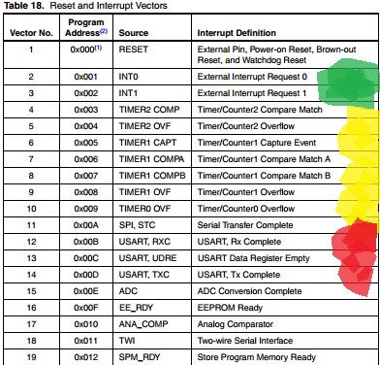
So what interrupts does ATmega8 have?
External voltage signal causes interrupt(PD2, PD3)
Timer/Coutner interrupts
Serial interrupts
ADC, EEPROM and other…
p. 46 of atmega8 doc

Slide 42
Examples on using interrupts
using interrupts in Timer/Counter:
So how to do something exactly at the moment timer scores 103 (or your target value)?
We need interrupt to react to such an event.
All timer/counters have compare registers. They can initiate interrupt upon timer reaching the value to which such register is set.
Example:
TIMSK = 1<<OCIE1A; //enable compare interrupt, TIMSK means Timer Interrupt MaSK
OCR1A = 103;
ISR(TIMER1_COMPA_vect)
{
PORTB^=1<<PB0;
}

Slide 43
Examples on using interrupts
Sometimes executing your normal program can be more important than your interrupts. To decide on this you have sei(); and cli(); functions.
You start with interrupts disabled.
sei(); enables them.
cli(); disables them.
Important register to set are MCUCR(MCU Control Register), GICR(General Interrupt Control Register). Refer to page 66 of atmega8 doc.
NOTE normal variables can not be changed in an interrupt. Please add volatile modifier in the declaration to enable this!
volatile int myNumber1=1, myNumber2=2;

Slide 44
More possibilities with interrupts
With the interrupt you can do more useful things, example:
Make phase-correct response to an event with unknown or changing period
React quickly to an important external event
Act at a precisely defined moment
Read serial input when it is ready
Or just use them to sequence your program to your preference..(but do not complicate your code for no good reason!)
Please discuss which interrupts can be helpful in every case!

Slide 45
Task 2.5 Interrupts (from practicals 1)
Expand the flashing LED program, that a second LED flashes faster and
the third LED is controlled with the buttons.
Use only interrupts to realize this.
Please disconnect the LCD display and remove all LCD functions to use the external interrupts.

Slide 46
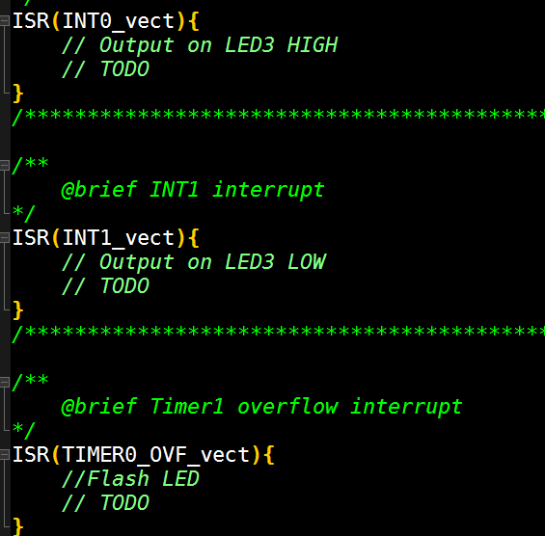
Interrupts – code template
The task itself does not specify, how exactly we should accomplish it. To know what to do, lets look at the hints in the template:

Slide 47
Interrupts – ISRs code snippets
So, there are already pre-defined ISRs(Interrupt Service Routines) which suggest which interrupts are needed:
ISR(INT0_vect)
ISR(INT1_vect)
ISR(TIMER0_OVF_vect)

Slide 48
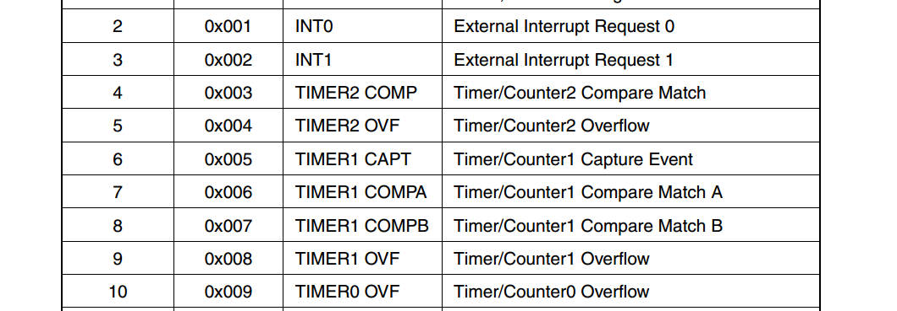
Hardware/software interrupts ATmega8
How to use this hint? Lets read about corresponding interrupts in the datasheet!
In the handbook (atmega8.pdf), open Interrupts:
So INT0 and INT1 are alternative functions of PD2 and PD3 pins!
We could use this for our task to control the state of LEDs with buttons!
And TIMER0 OVF overflow will be called each time the timer 0 counts to the selected prescaler value. We could use it to blink the LED, also much faster then 1 Hz from task 2.4!

Slide 49
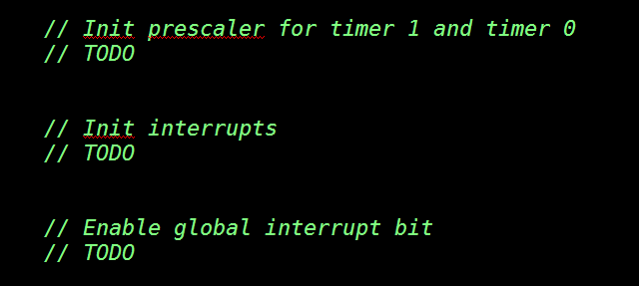
Back to task 2.5
The easy parts are 1st and 3rd:
1st: You already know how to work with prescaler. Find the right register and bit names, look for it in Timer/Counter0 section of the datasheet.
…
3rd: sei();
Use cli(); to disable the interrupts.
(you don‘t need this in basics lab)

Slide 50
Initialisation of Interrupts
Now 2nd:
We will work with:
General Interrupt Control Register (GICR);
MCU Control Register (MCUCR);
Timer Interrupt Mask (TIMSK).
The next slides will give you details about registers and bits from the datasheet. You have to decide what settings you need.

Slide 51
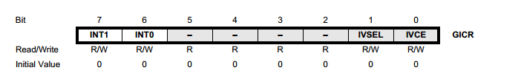
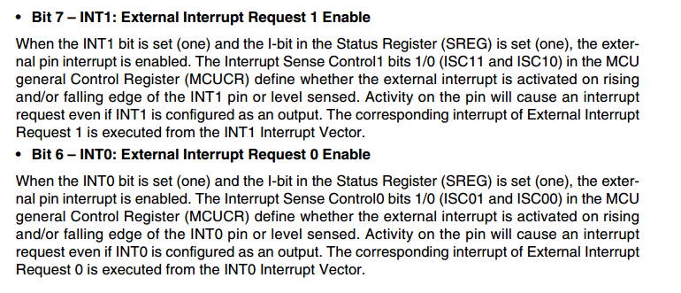
General Interrupt Control Register
General Interrupt Control Register (GICR);

Slide 52
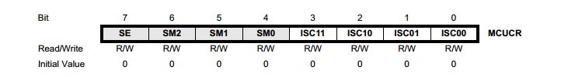
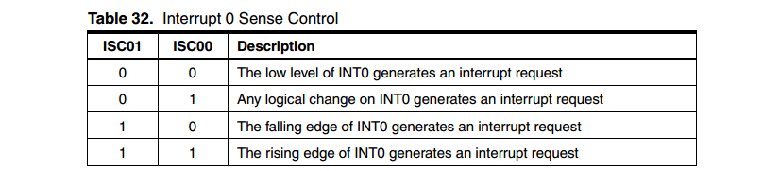
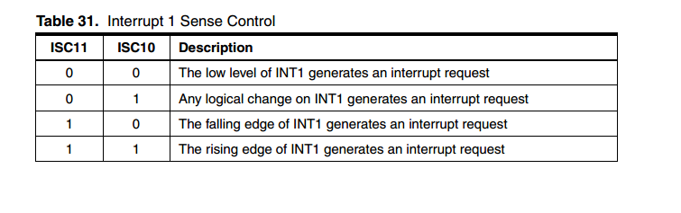
MCU Control Register
MCU Control Register (MCUCR);
Please note: Our pushbuttons are connected as active low!

Slide 53
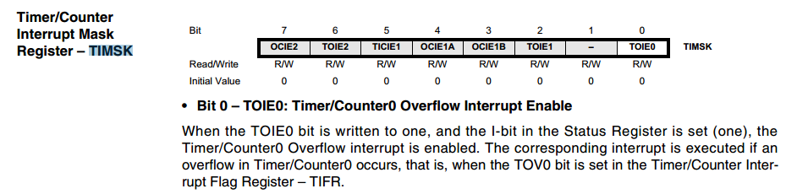
Timer Interrupt Mask Register
Timer Interrupt Mask (TIMSK)
Remark: the text talks about I-bit of Status Register. This is about global interrupt enable bit, which you set / unset using the functions sei() and cli().

